Slide 1
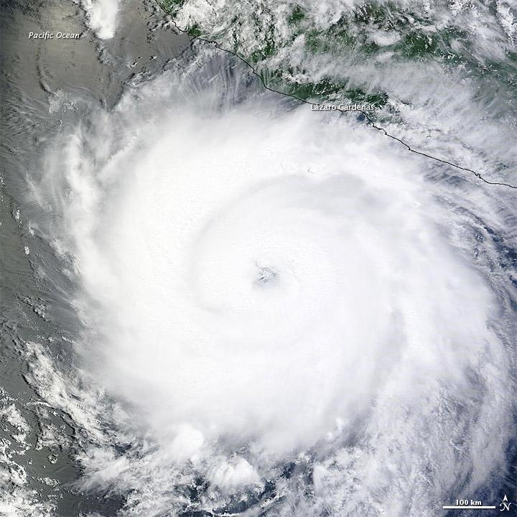



The (Parcel-Scale) Wind Downscaling for NOAA’s COASTAL Act Project: Hurricane Michael (2018) and Hurricane Irma (2017) Case Studies
(NOAA - COASTAL-Act Project)
Anil Kumar^{1,2}, Avichal Mehra², Zaizhong Ma^{1,2}, Roshan Shrestha^{1,2}, Andre van der Westhuysen^{1,2}, Ali Abdolali^{1,2}, Saeed Moghimi³, Maoyi Huang⁴
¹ I. M. System Group at EMC/NCEP/NOAA, College Park, MD USA
²Enviromental Modeling Center (EMC), NOAA, , College Park, Maryland, USA
³CSDL/NOS/NOAA, ⁴OSTI/NWS/NOAA
AMS 102nd ANNUAL MEETING Houston, TX, 23-27 January 2022 20th Symposium on the Coastal EnvironmentEnvironments

Slide 2
OUTLINE
COASTAL-ACT - OBJECTIVE
DOWNSCALING FRAMEWORK
Forcing HWRF & HRRR
Implementation of High-Resolution Elevation and Land Use
ADCRIC High water mark Inundation implementation
Challenges
Final Summary

Slide 3
COASTAL ACT - WIND ANALYSIS DOWNSCALING COMPONENT
(COASTAL) Act requires a wind analysis and to estimate the strength and timing of damaging winds at a given, “parcel-scale (10-30 meters)” over-land location in the area impacted by the tropical cyclone and to drive surge and wave models for estimating the water damage.
The Consumer Option for an Alternative System to Allocate Losses (COASTAL) Act The Consumer Option for an Alternative System to Allocate Losses (COASTAL) Act was signed into law on July 6, 2012. The purpose of the COASTAL Act is to lower costs to FEMA’s National Flood Insurance Program (NFIP) by better discerning wind versus water damage in the case of “indeterminate losses”.

Slide 4
COASTAL-Act Model Framework
HWRF FORCINGS
(DA, ensemble )
LANDUSE (30-METER) 40 CATEGORIES NLCD(2011)
ELEVATION- USGS (2013) 1/3
arc-sec, 10-METER RES
WPS
SYSTEM
2D Surface winds, sfc pressure
From URMA/RTMA
Hourly
NUDGING
WATER INUNDATION
Max water surface elevation from ADCIRC model
(Time-Dependent)
OUTPUTS (Surface) 15 mins average
Sfc Wind Speed Max (m/s), U10 & V10 Time of Max Sfc Wind speed, Mean wind speed 6. Standard Dev. Wind Speed, Mean SLP, 30-meter LANDUSE, 10-meter ELEVATION TERRAIN, Water Inundation mark
Fine simulation WRF-LES
(10-30 meter)
OUTPUTS (ATMOSPHERE) 15 mins average
1. Wind Speed Max (m/s) 2. Max Updraft Helicity 3. Updraft Helicity 4. Max Z-wind updraft 5. Max Z-wind downdraft 6. Mean Z-wind 7. Max col integrated Graupel

Slide 5
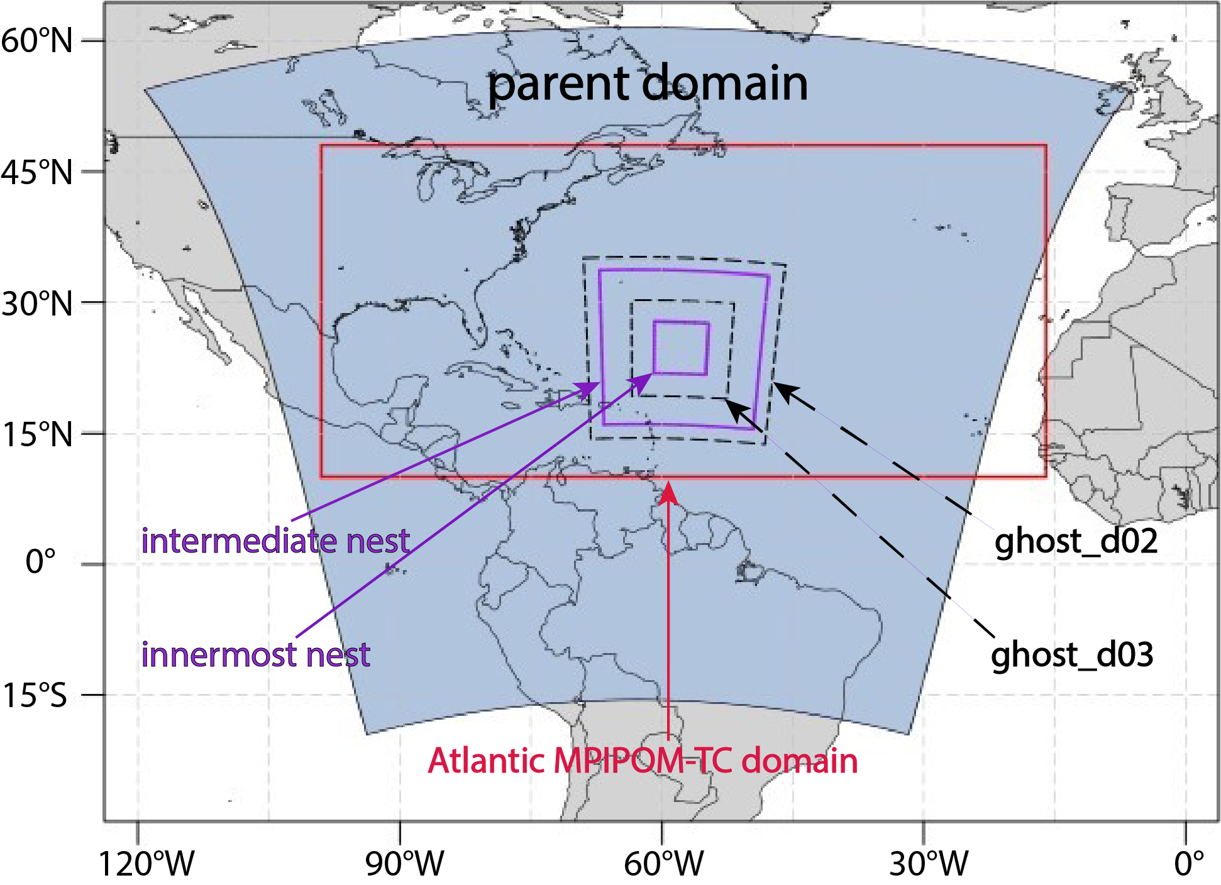
Operational HWRF v12 (Hurricane Weather Research and Forecast) System
PRIMARY FORCING
HWRF continuously improved in the past decade through support from HFIP
Successful community modeling approach for accelerated transition of research to operations
Three nested domains at a horizontal resolution of 13.5/4.5/1.5 kms
Formal vortex initialization and GSI-based data assimilation
Actively coupled to Ocean models in all global basins
Actively coupled to Wave model (WW3) in NHC basins
Inner-core DA including real-time data from recon missions (TDR, dropsondes, SFMR etc.)

Slide 6

URMA Wind Analysis Workflow
Acquire database
Pre Processing
Model Run
Additional Surface FORCING
HRRR/RAP
Prepbufr / Smartinit
URMA-GSI [2D-Var]
And post analysis
HWRF
Blending
SFMR
Obs processing
Observation
Output Validation
CWWED
CWWED
Feed the output to Downscaling
NCEP Data Tank

Slide 7
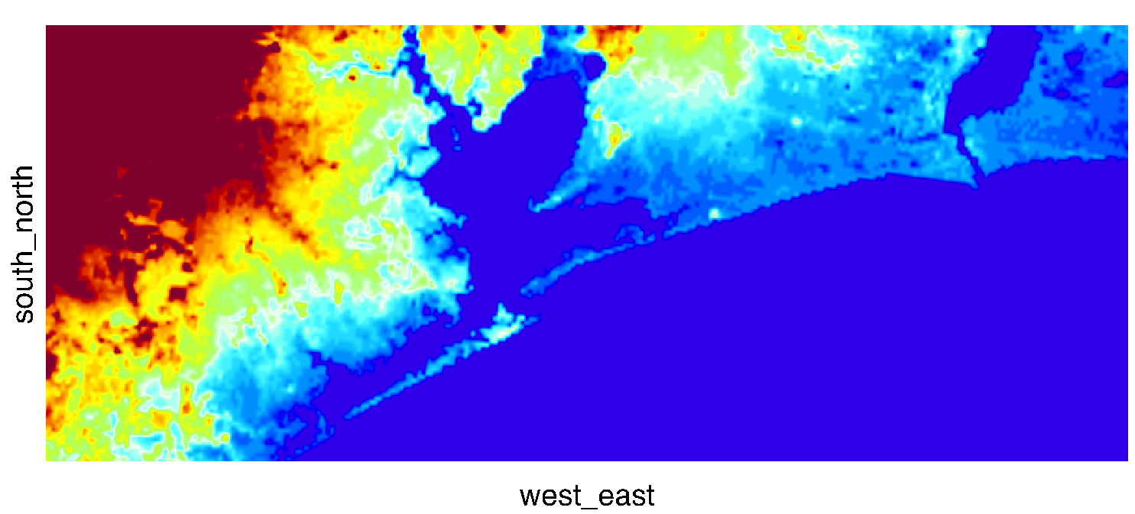
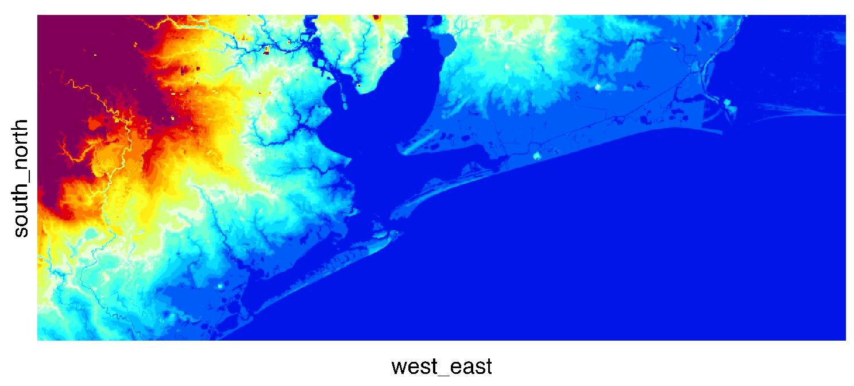
EXAMPLE
(Terrain data comparision)
Terrain data: 1-Km Resolution
GMTED2010 30-arc-second (1-Km resolution) topography height. The Global Multi-resolution Terrain Elevation Data 2010 (GMTED2010). By USGS and National Geospatial-Intelligence Agency (NGA).
Terrain Data : 10-meter resolution
U.S. Geological Survey (USGS), 2013, USGS National Elevation Data (NED) 1/3 arc-second (10-meter resolution)

Slide 8
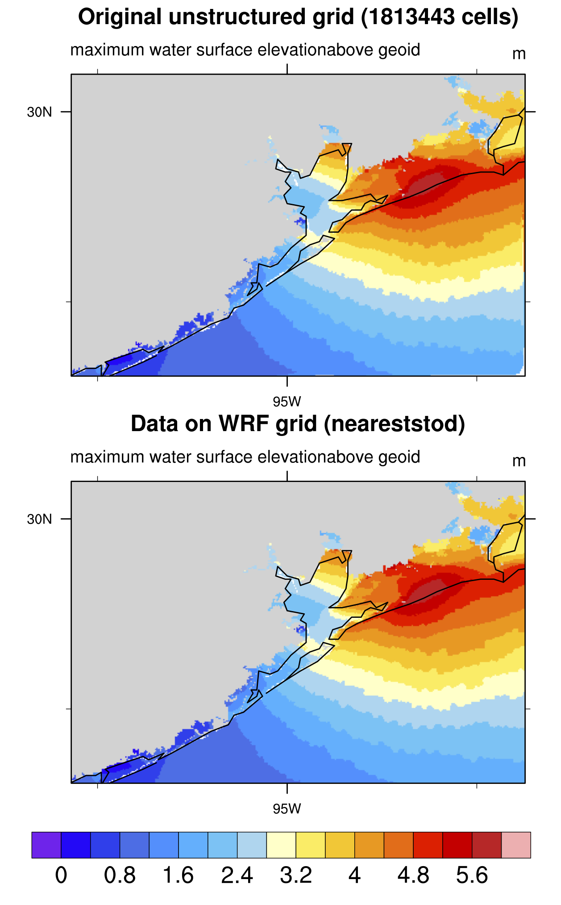
Water Inundation – Summary Points
EXAMPLE
Implementation of Max Water surface elevation in the WPS –WRF System for LES (Hurricane Ike-2008)
Hurricane Ike (2008)
1. mapping the high water level [aka inundation] data from is unstructured grid to the WRF-ARW grid
2. where Maximum water surface greater than the model's terrain, we set landuse to open water.
3. not changing the land-sea mask nor the terrain height or sfc-pressure in the model.
Interpolation Method: nearest neighbor method
We have done this using NCL V6.4.0 (or higher)

Slide 9
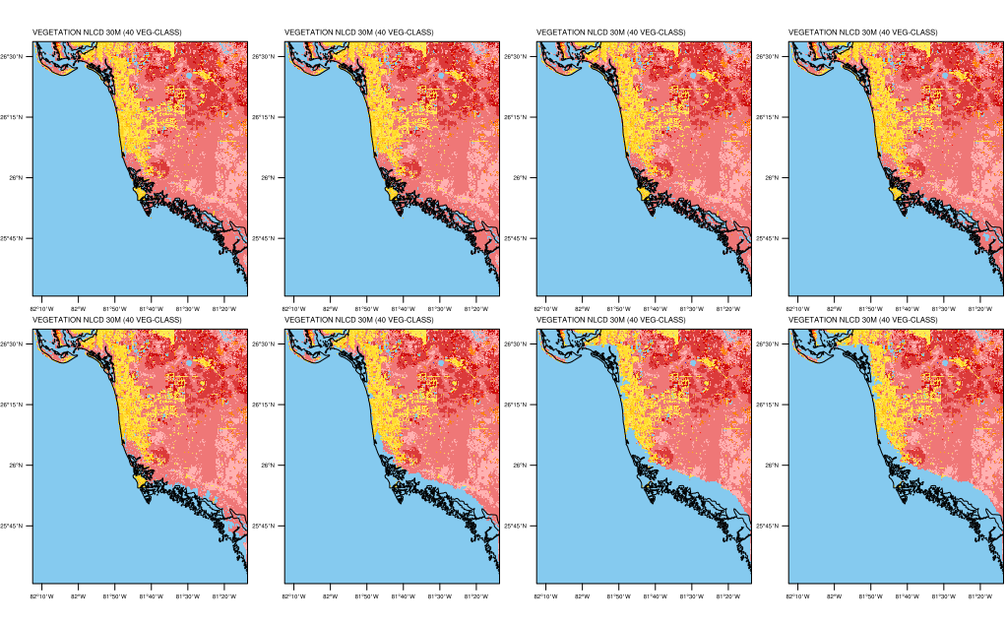
Hurricane IRMA (2017)
Time-dependent Inundation Details
15 UTC/10
18 UTC/10
21 UTC/10
12 UTC/10
00 UTC/11
03 UTC/11
06 UTC/11
09 UTC/11

Slide 10
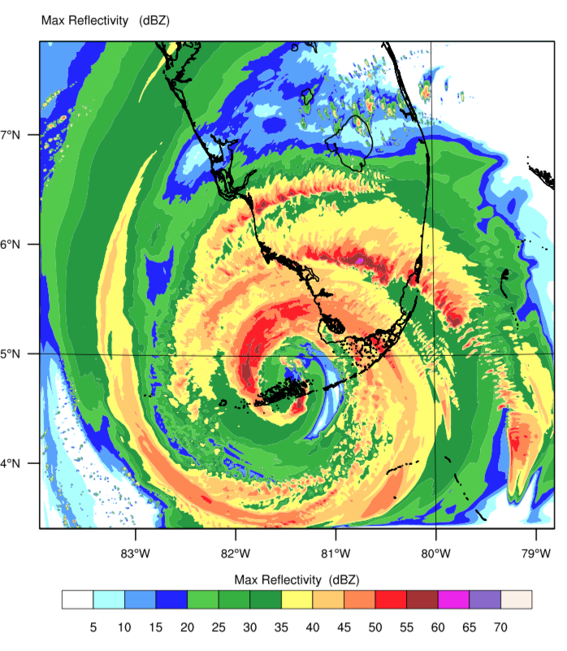
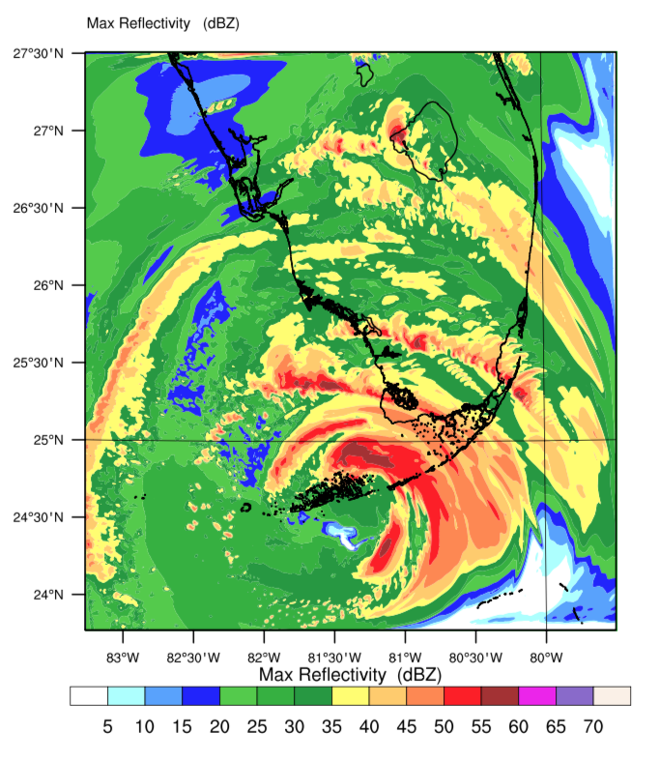
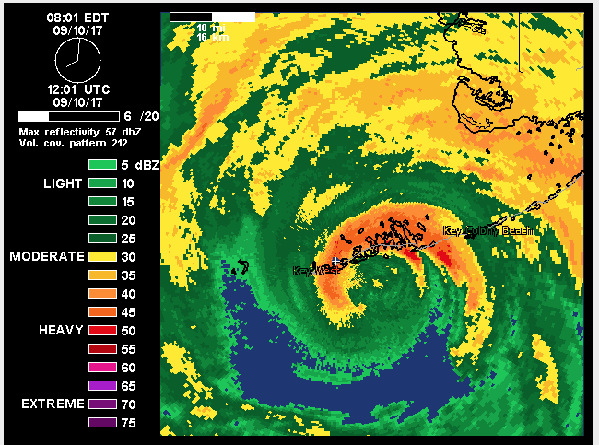
Reflectivity from LES using HWRF and HRRR forcing – from Domain-1 LES Output
12 UTC 10 SEPT 2017 (Landfall Time at Key West, FL)
Doppler Radar at 12 UTC
LES (HWRF) Max Reflectivity
LES (HRRR) Max Reflectivity
Eye location is better captured in LES result from HRRR forcing.
Very strong hurricane eye (overestimated) in HWRF based results.

Slide 11
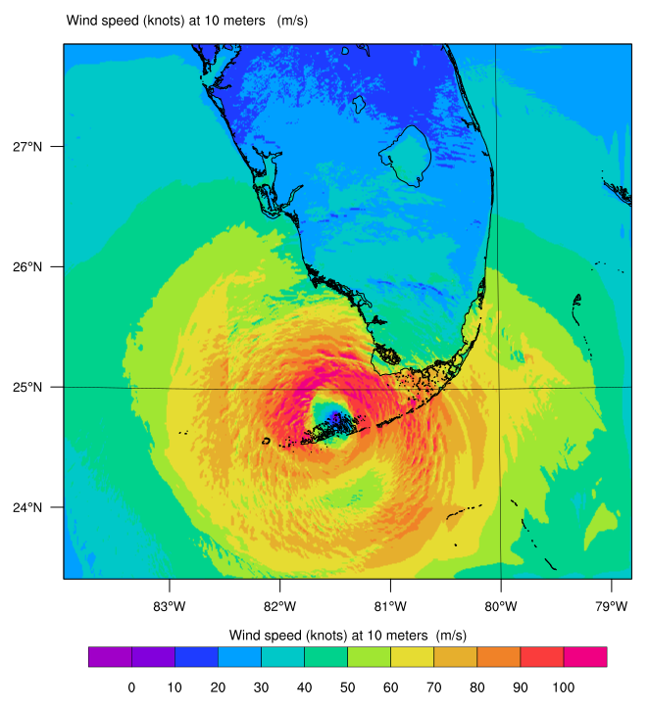
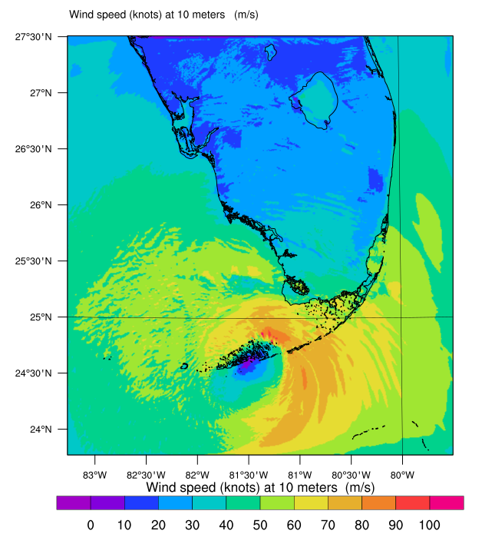
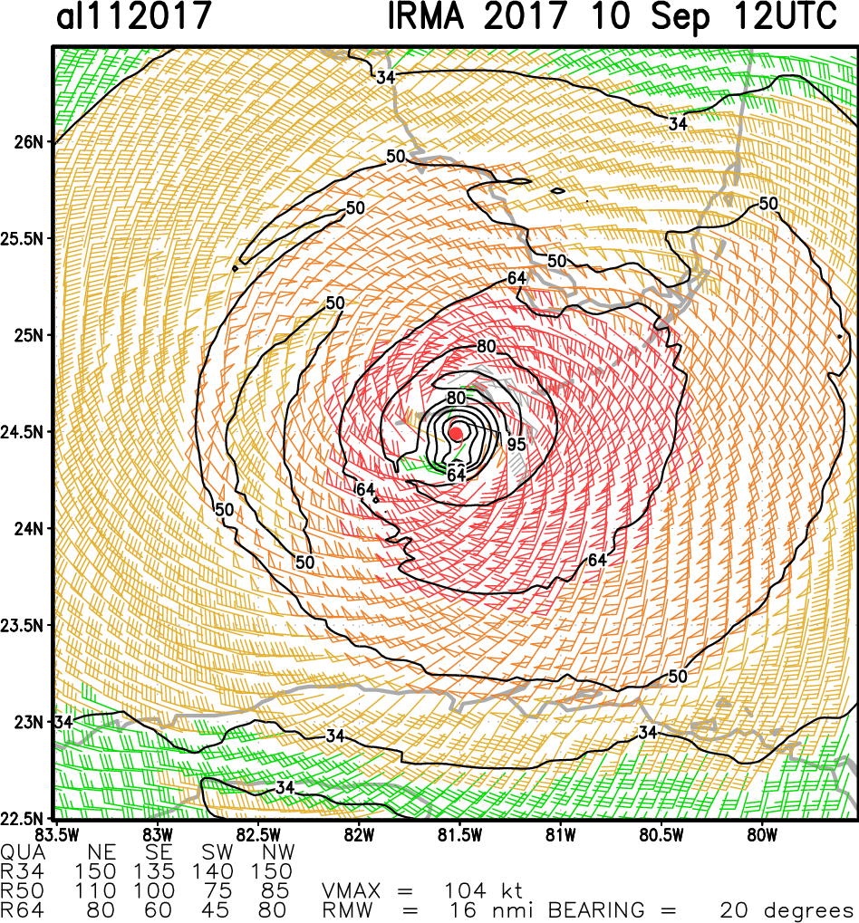
LES based Surface wind speed from HWRF and HRRR forcing – from Domain-1 LES Output
12 UTC 10 SEPT 2017 (Landfall Time at Key West, FL)
Satellite + Aircraft based Surface winds at 12 UTC
LES (HWRF) SFC Wind Speed
LES (HRRR) SFC Wind Speed
Surf wind speed is better captured in LES result from HRRR forcing (with some minor issues).
Overestimated wind speed in HWRF based results >90 knots around the hurricane eye and much of the region.

Slide 12
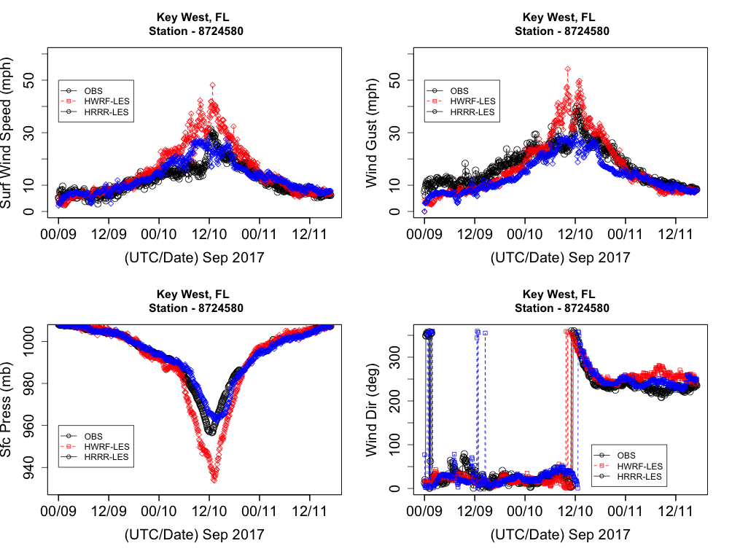
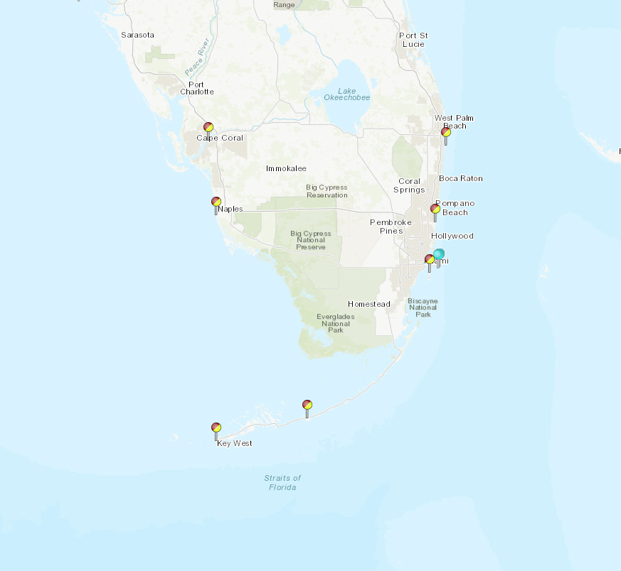
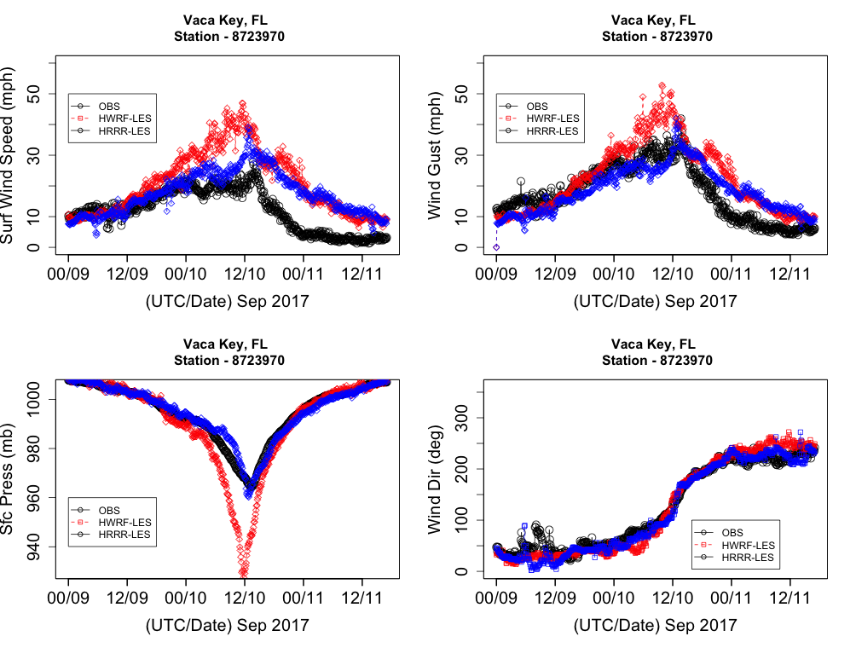

Slide 13
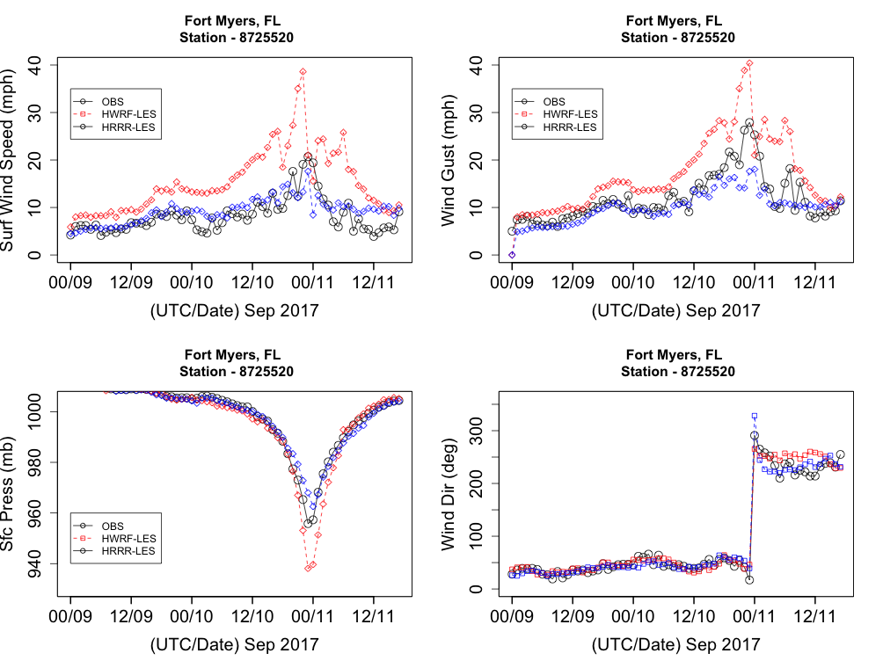
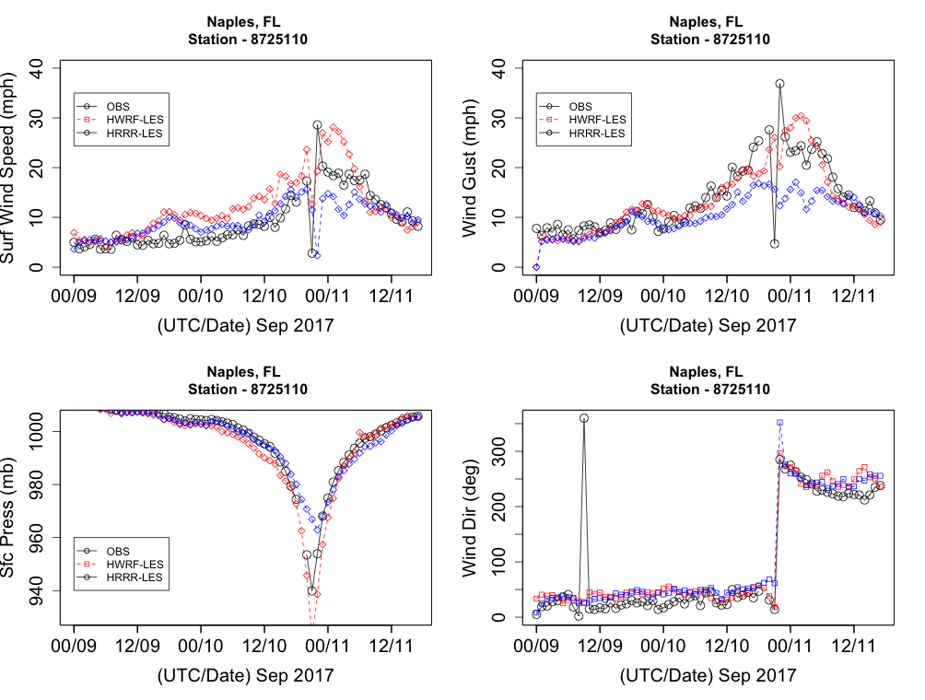

Slide 14
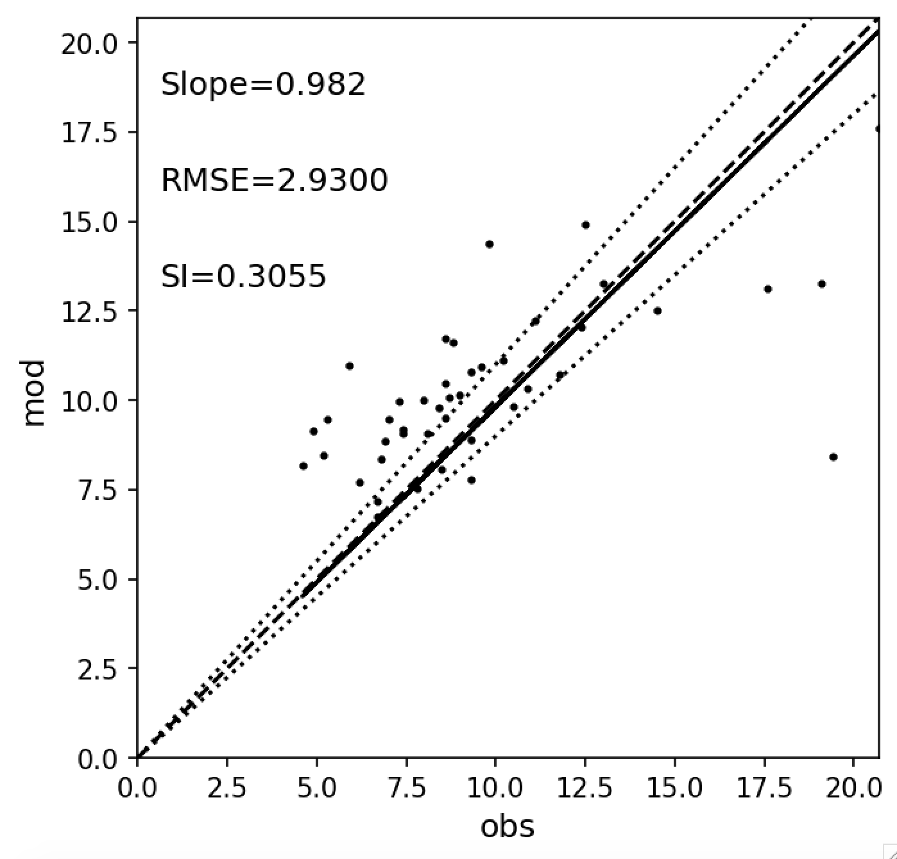
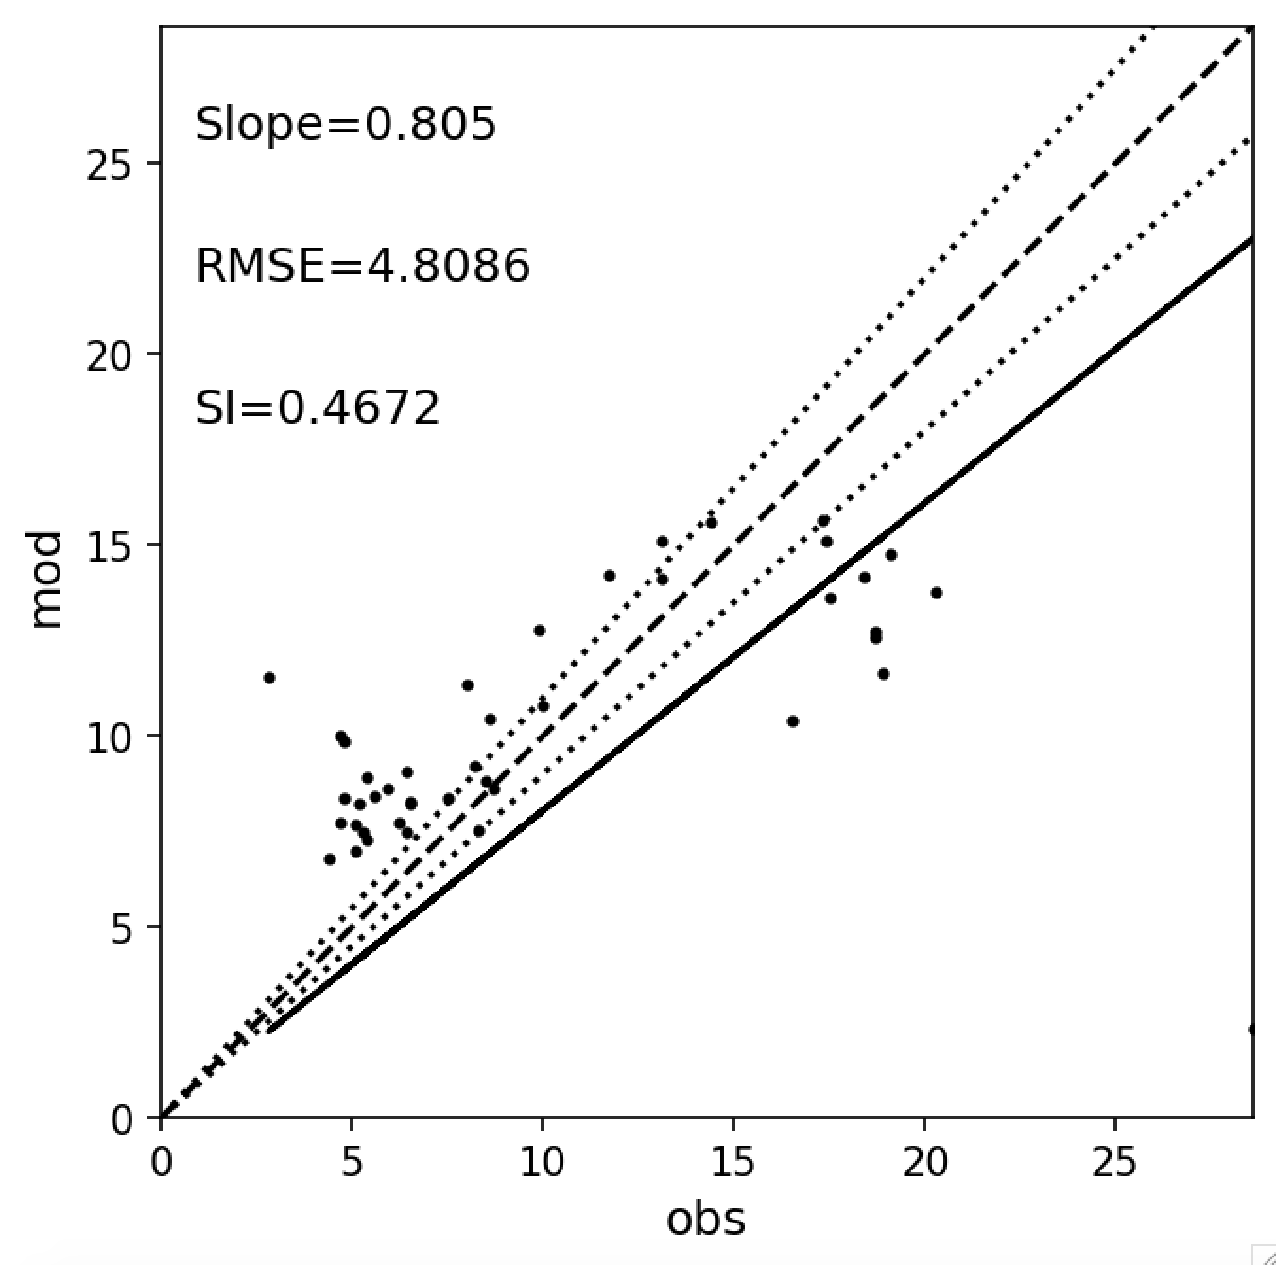
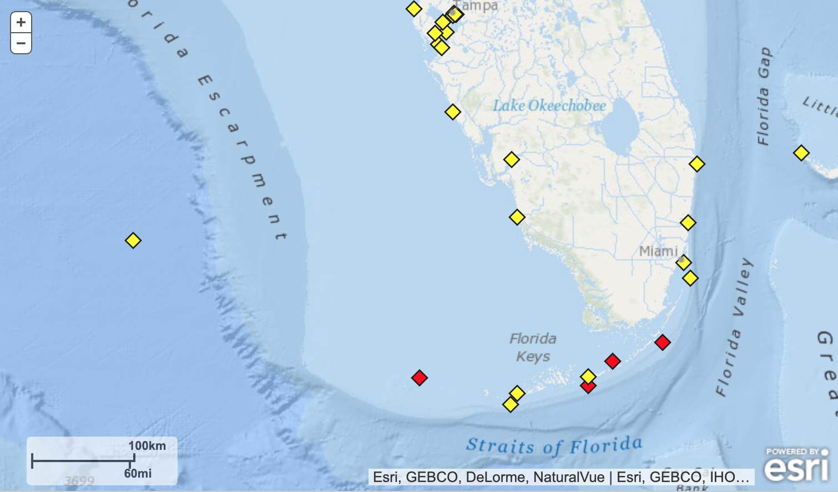
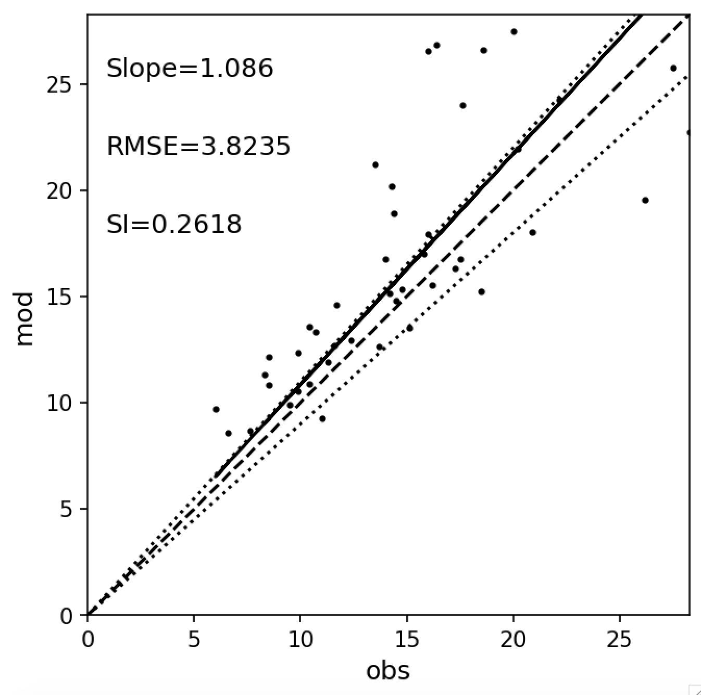
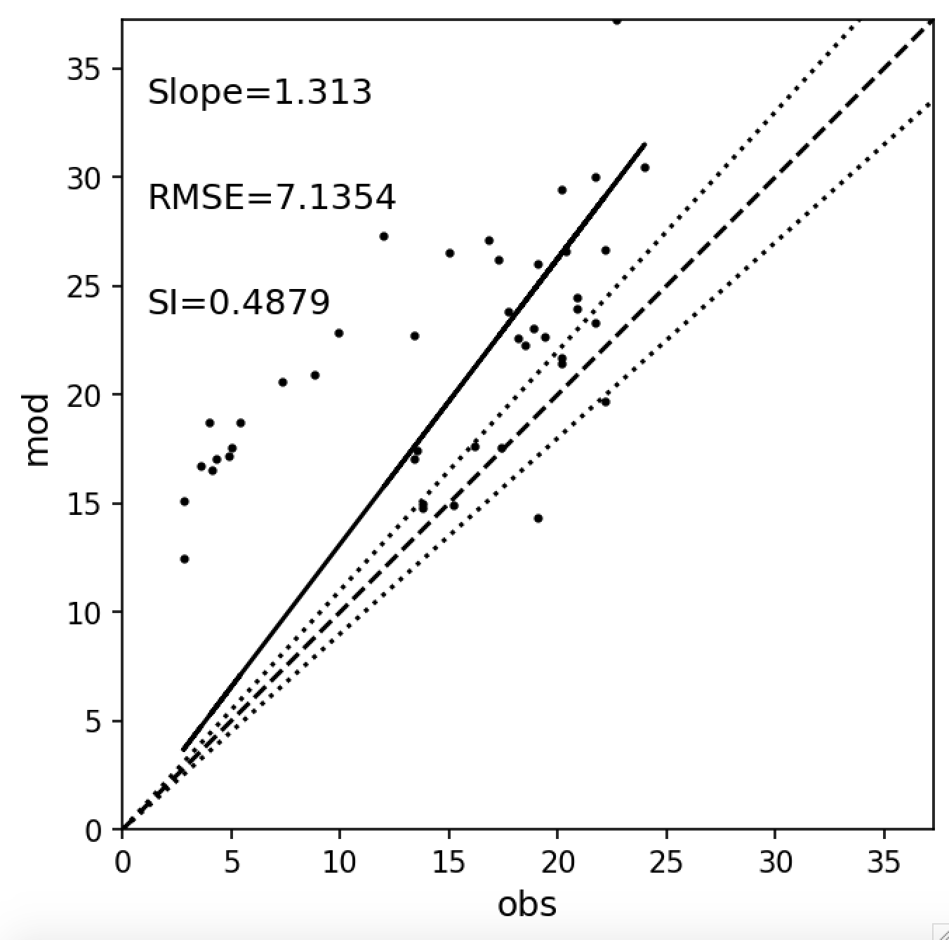
Validation Scritps for 90% accuracy
Tier 1: General error statistics (U10)
Fort Meyers
Naples
Fort Meyers
Naples
Vaca Key
Key West
Key West
Vaca Key

Slide 15
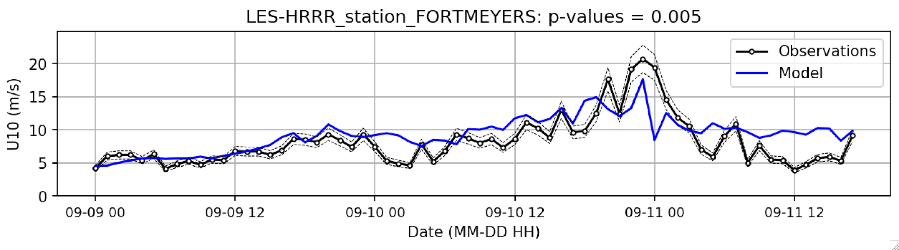
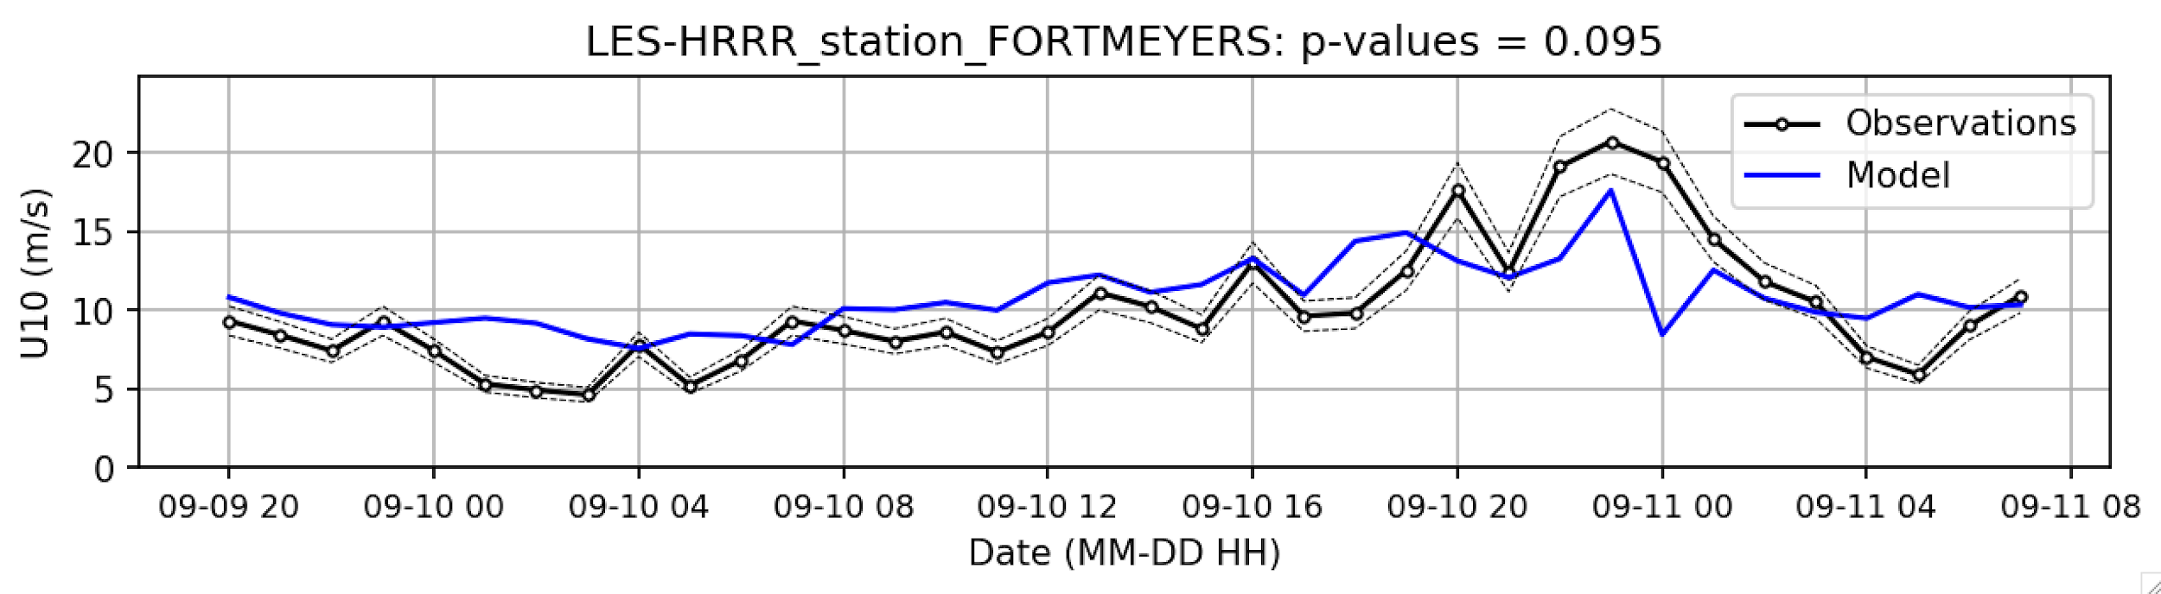
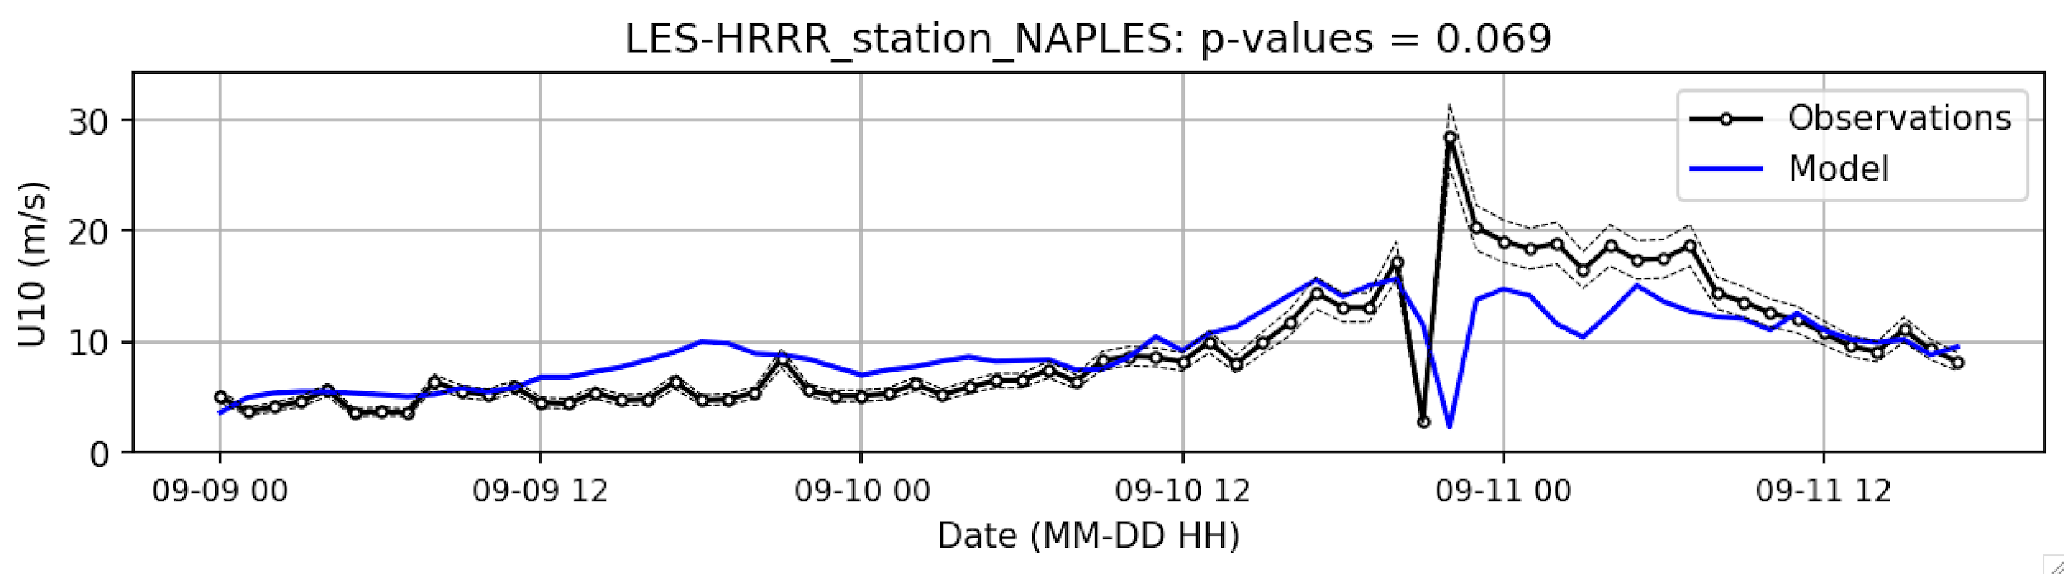
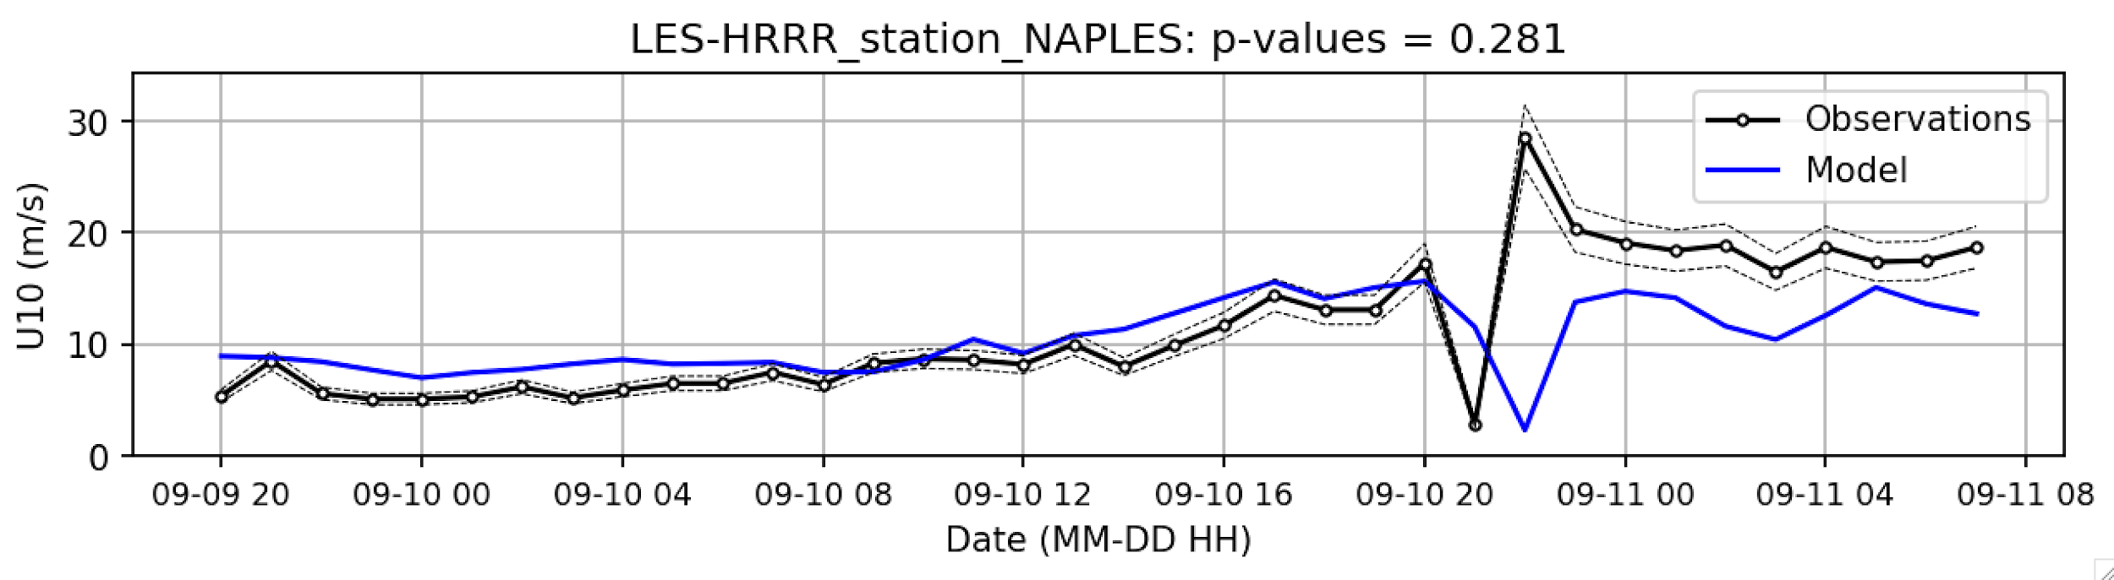
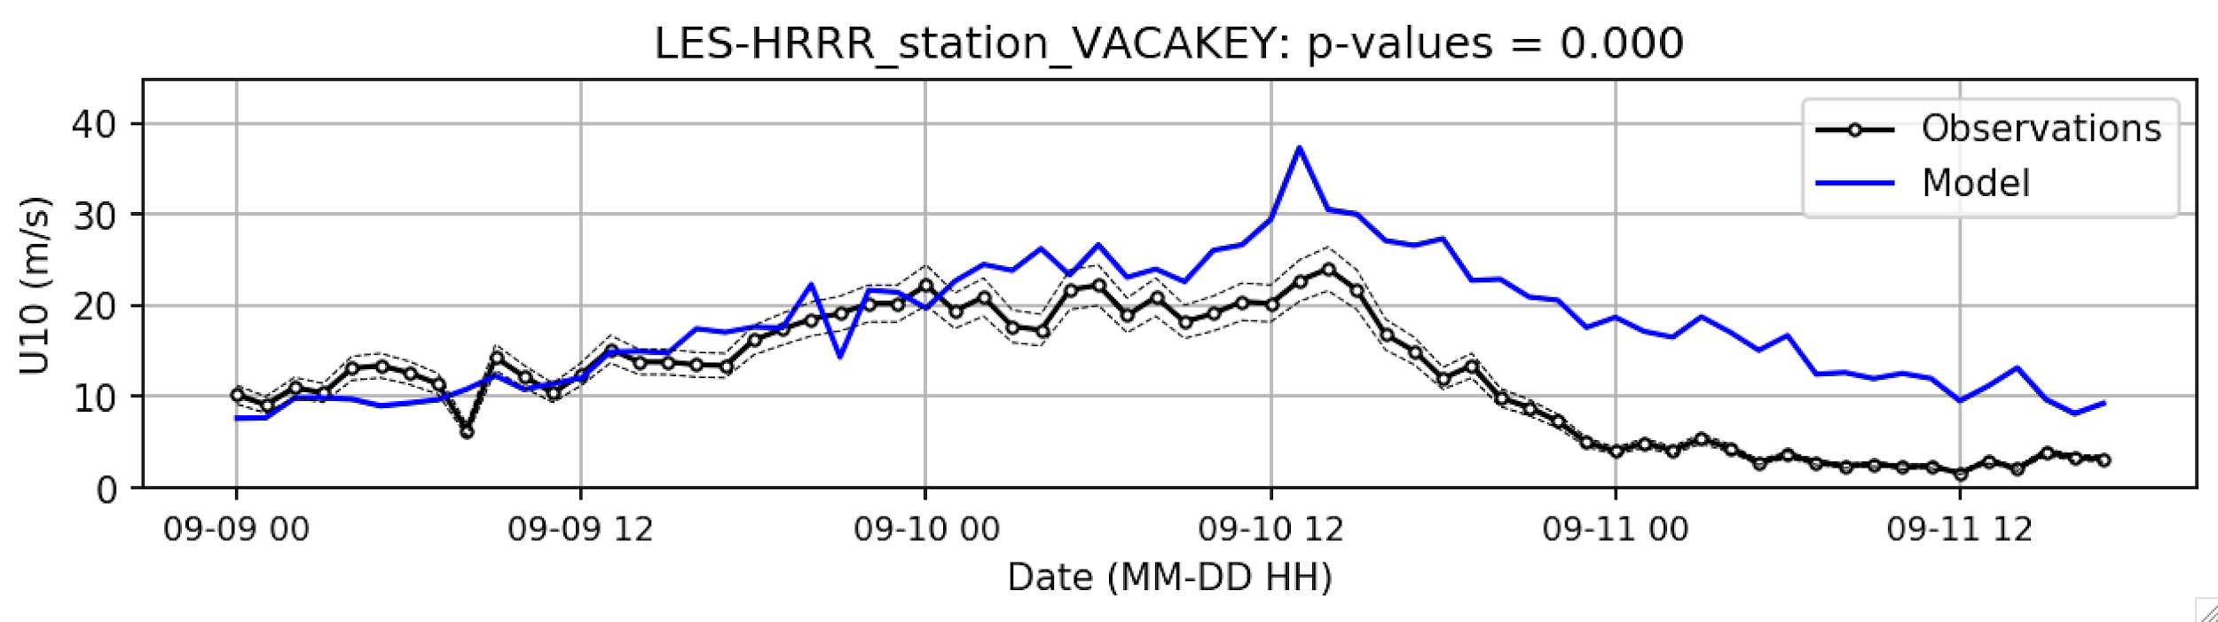
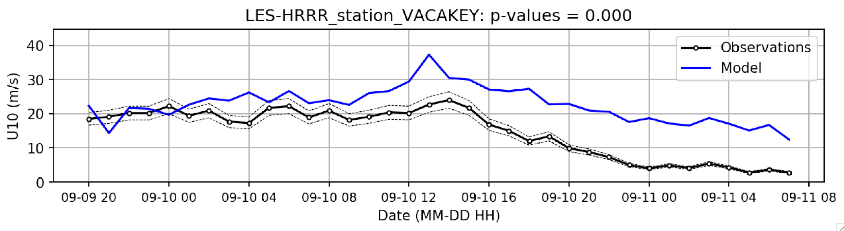
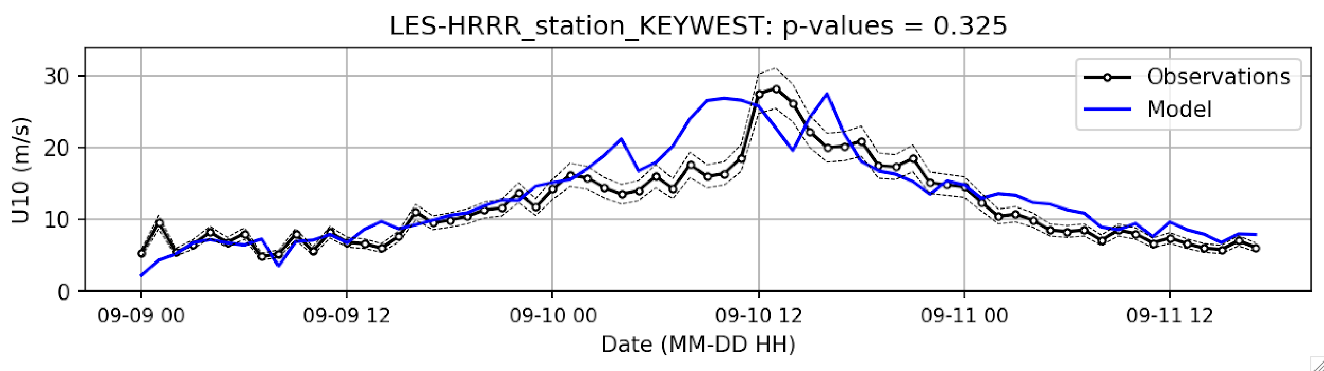
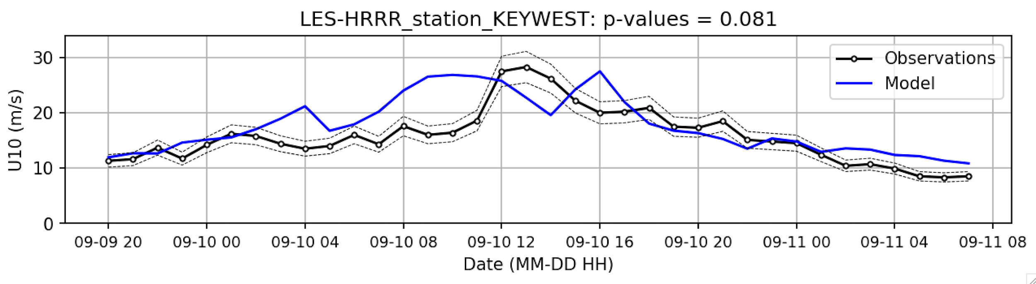
Tier 2: 90% accuracy with time window (U10)
FAIL
SUCCEED
SUCCEED
SUCCEED
FAIL
FAIL
FAIL
SUCCEED
SUCCEED

Slide 16
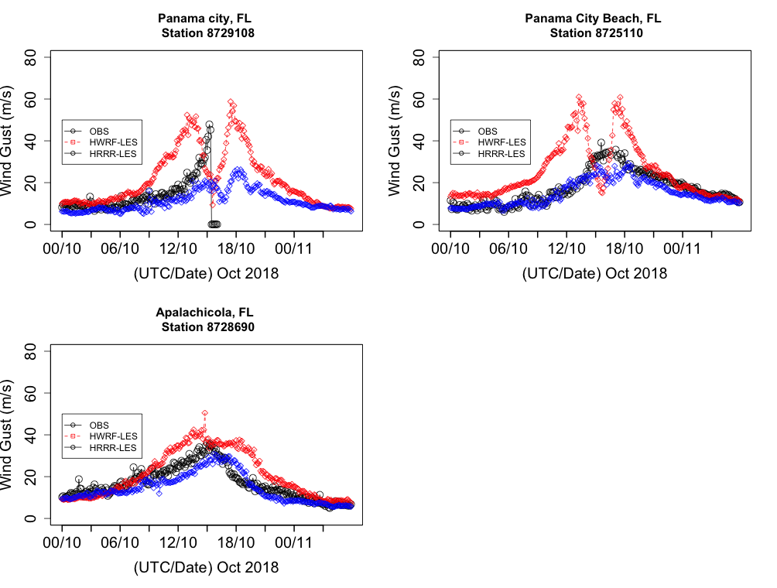
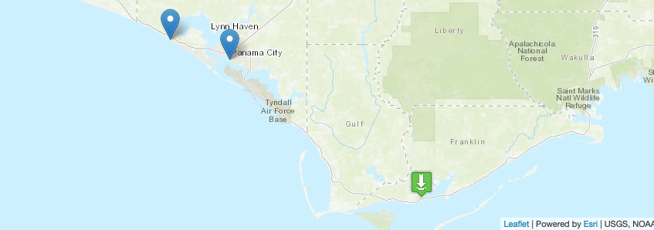
HURRICANE MICHAEL 2018
RED – LES USING HWRF FORCING
BLUE – LES USING HRRR FORCING
BLACK – OBSERVATIONS
6-MINS INTERVAL DATA & MODEL VALIDATIONS
WIND GUST 6-MINS INTERVAL OBS DATA & MODEL

Slide 17
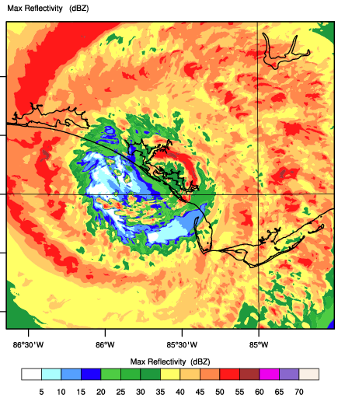
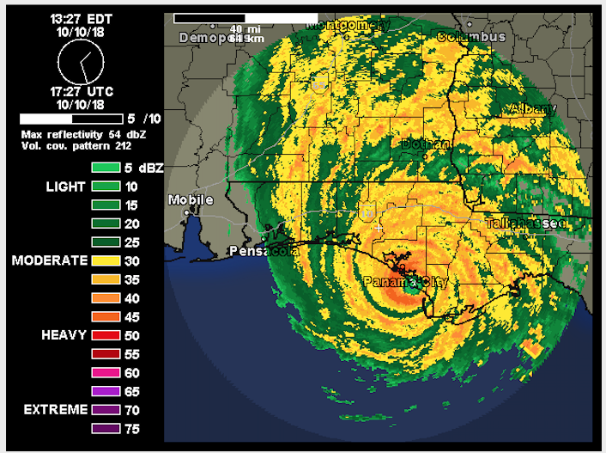
CHALLENGES
HWRF/LES Eye
Observed Eye
Model Reflectivity dBZ Domain 2 (90 meter)

Slide 18
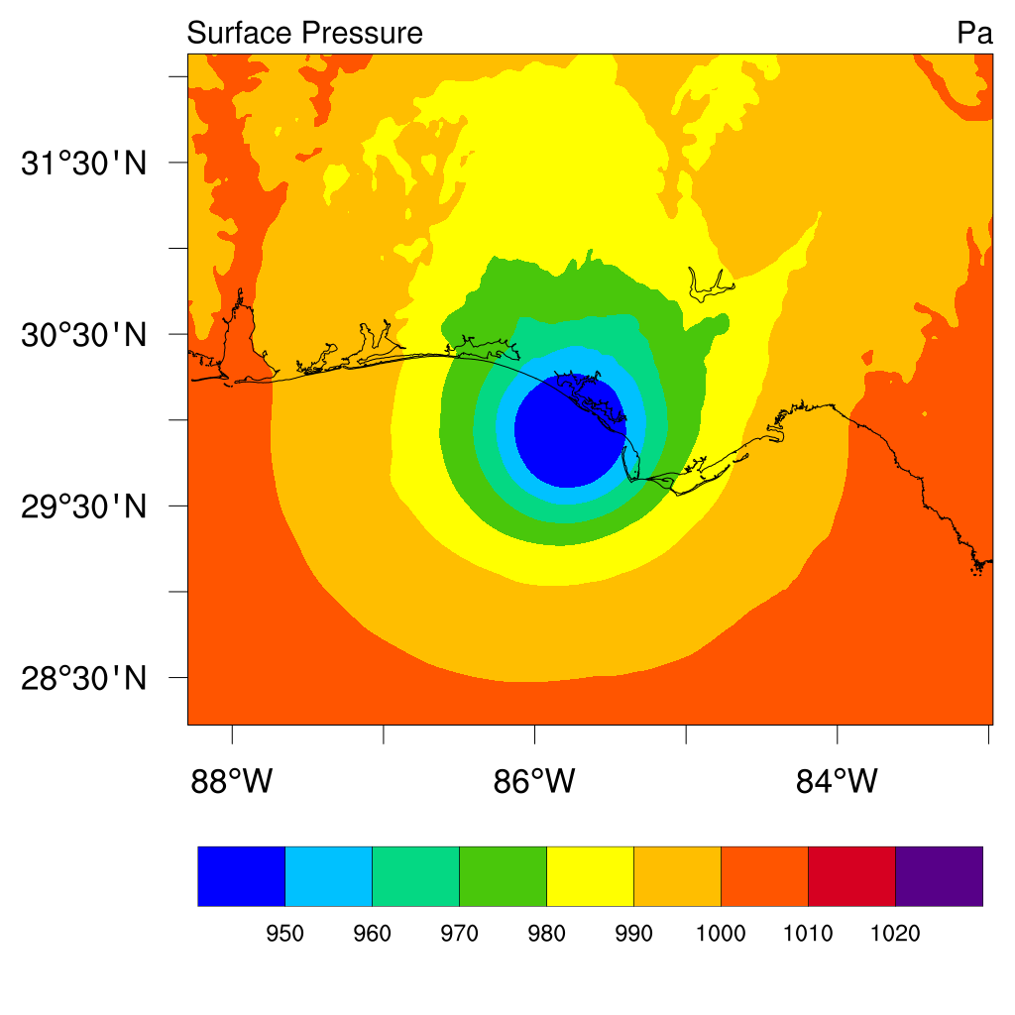
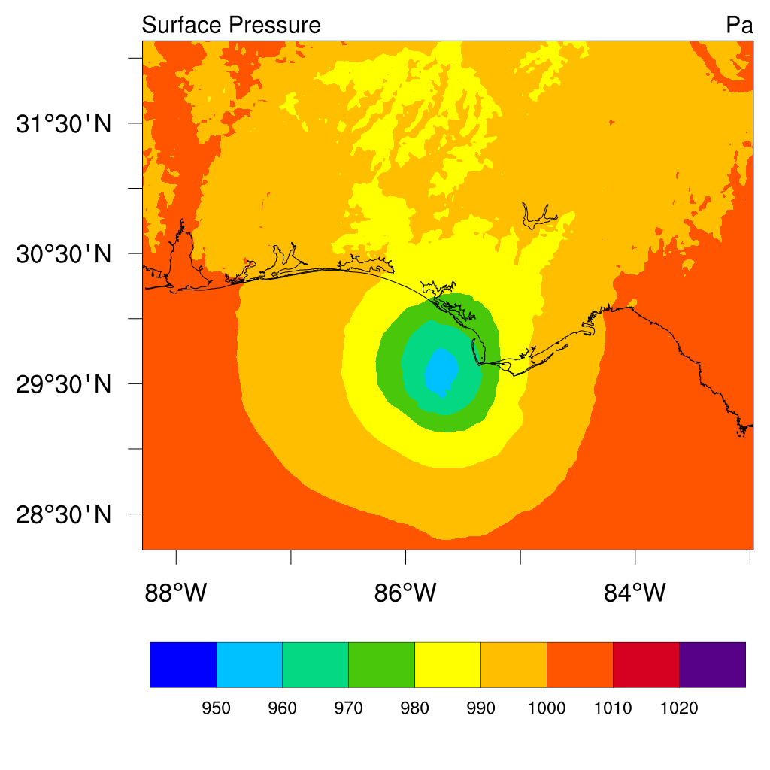
1700 UTC 10 Oct 2018
HWRF
HRRR

Slide 19
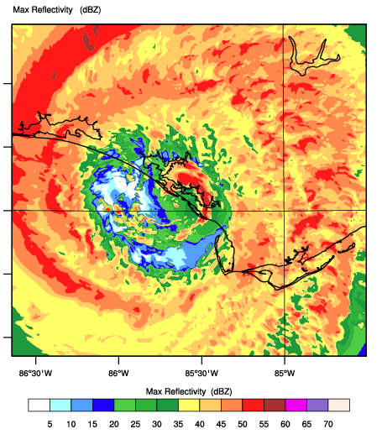
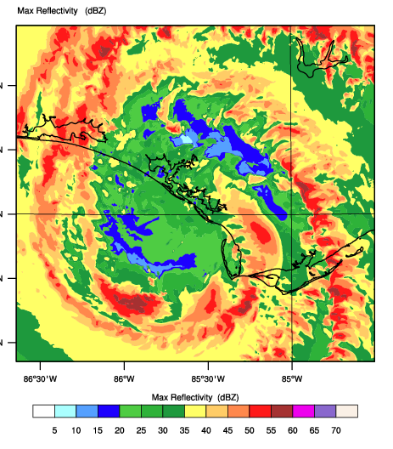
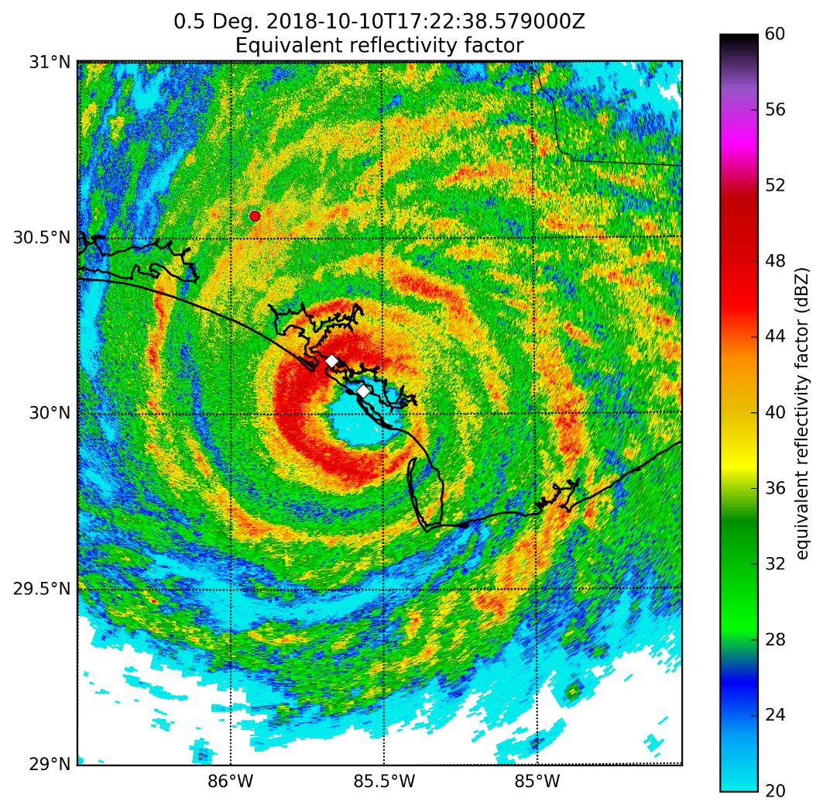
2400 UTC 17 OCT 2021
NEXRAD
LES_HWRF
LES_HRRR
MODEL REFLECTIVITY COMPARED WITH NEXRAD REFLECTIVITY

Slide 20
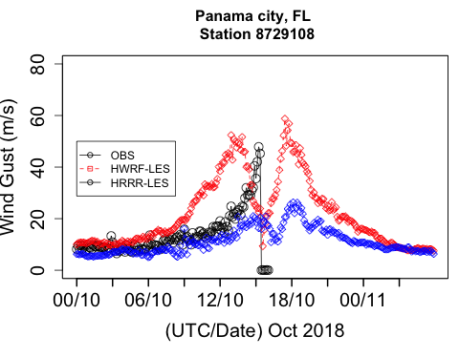
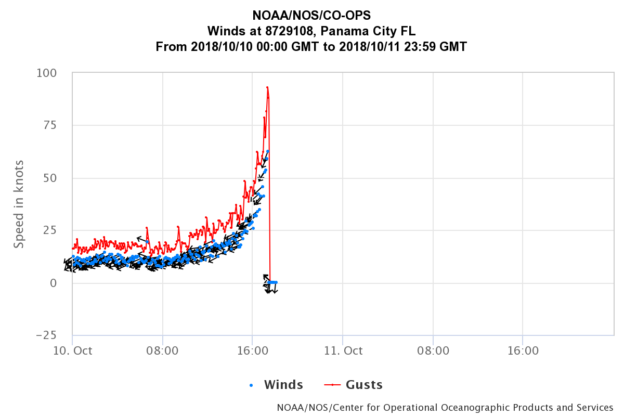
Downburst
SOURCE: Ken Pryor (NOAA)

Slide 21
SUMMARY & CHALLENGES
The Downscaling Framework completed and Implemented. Workflow work is in progress.
Every Hurricane case is challenging at Parcel-scale.
Tested Cases: Ike (2008), Sandy (2012), Florence (2017), Irma (2018), Micheal(2018), Iselle (2014).
High-Resolution elevation and land-use data provides better realistic representation for coastal inundation impacts
Downscaling results are very sensitive to HWRF and HRRR forcings
Improvement can be achieved or depend upon mostly by improving HWRF data assimilation system and HRRR surface analysis.
Observations are very limited to conduct 90% accuracy statistics over LES domain. Exploring MET Plus software for point and grid evaluation.
Hurricane eye shapes and sizes are very challenging even in LES results and largely contributed eye size errors from forcing and nudging process.

Slide 22
THANK YOU!
Anil.kumar@noaa.gov

